Slide 1
.

Slide 2
Internal Assessment
Compulsory for both SL and HL
Demonstrate application of skills and knowledge and pursue a topic of personal interest or enhance syllabus coverage
Should be woven into normal classroom teaching and not be a separate activity conducted after the course has been taught
Historical investigation on a topic of their choice
Group work may NOT be undertaken

Slide 3
Internal Assessment
Divided into three elements
Identification and evaluation of sources (6 marks)
Explicit statement of research question
Evaluation of sources now includes origin, purpose and content to analyse their values and limitations
Investigation (15 marks)
Combines evidence with analysis
Must provide a reasoned conclusion in this section
Reflection (4 marks)
Entirely new – use the Subject guide for specific details
Bibliography/Referencing not awarded marks (still required)
Word Limit 2,200
IA assessment criteria and rubric – see subject guide pages 86-92

Slide 4
The IA Task: Historical Investigation
Three sections:
Identification and evaluation of sources
Investigation
Reflection
The topic must be historical and therefore cannot be on an event that has happened in the last 10 years
Topic selection is free choice of student, but should be in consultation with teacher, and should ensure that there are sufficient resources available to support the investigation

Slide 5
Section 1: Identification and evaluation of sources (6 marks)
Requires students to analyse in detail two of the sources they will use in their investigation
Sources can be either primary or secondary
Students must:
Clearly state the question they have chosen to investigate (worded as a question)
Include a brief explanation of the nature of the two sources they have selected for detailed analysis, including an explanation of their relevance to the investigation
Analyse two sources in detail. With reference to the origins, purpose and content, the student should analyse the value and limitations of the two sources in relation to the investigation
Notes:
Use subject guide here page 92 to review recent examples of strong questions from student investigations and also looking at the six key concepts for the history course, causation, consequence, continuity, change, significance and perspectives and how these could be good starting points for an investigation
Refer back to the importance of a narrowly focused research question in the extended essay – same applies here
Comment on word count, importance that the investigation is focused
Use the rubric here to highlight what must be done

Slide 6
How to write Part 1 Historical Investigation

Slide 7
To Begin
There needs to be 4 paragraphs.
Introduction
Introduce your topic
Give some background knowledge
Lead up to the Topic Sentence
Topic Sentence needs to be in the form of a question
MUST BE THE LAST SENTENCE IN THE PARAGRAPH
Clarification of Topic and Research
Begin by restating what your research topic is
Explain what you are researching to answer your question
Next you need to tell me what kind of sources you are using
“This investigation is conducted through a variety of sources ranging from… “ (ex. Books, websites, newspapers, etc)
Explain why the two sources that are evaluated are important.

Slide 8
Evaluation of Sources
Paragraphs 3 & 4
Each paragraph is an evaluation of a separate source.
You need to evaluate the sources by explaining ,in order, their Origins, their Purpose, their Content, and the Values and Limitations.
OPCVL
You use the OPC to determine the V+L.
You must have at least 3 Values and Limitations for each source that is being evaluated.
You are basically explaining how your sources are useful for your research or not.

Slide 9
Section 2: Investigation (15 marks)
Consists of the actual investigation
Should be clearly and effectively organized
There is no prescribed format
It should contain critical analysis that is focused clearly on the question being investigation
Should also include the conclusion that the student draws from their analysis
Students should use a range of evidence to support their argument (primary, secondary or a mixture)
To score above 6, must include an analytical component
Notes:
Use the rubric here to highlight what must be done

Slide 11
Draw YOU getting up in the morning.
Put your bed someplace strange.
Call the picture:
Getting UP on the WRONG SIDE of the BED.

Slide 12
Section 3: Reflection (4 marks)
Requires students to reflect on what undertaking their investigation highlighted to them about the methods used by, and the challenges facing, the historian
See subject guide page 93 for examples of discussion questions that may help reflection
Notes:
Use the rubric here to highlight what must be done
Have participants look at the examples of discussion questions that may help to encourage reflection from the subject guide page 93

Slide 13
Section 2: Investigation This section of the internal assessment task consists of the actual investigation.

Slide 14
The internal assessment task provides scope for a wide variety of different types of historical investigation, for example: • a historical topic or theme using a variety of written sources or a variety of written and non-written sources • a historical topic based on fieldwork, for example, a museum, archeological site, battlefields, places of worship such as mosques or churches, historic buildings • a local history study.

Slide 15
The investigation must be clearly and effectively organized. While there is no prescribed format for how this section must be structured, it must contain critical analysis that is focused clearly on the question being investigated, and must also include the conclusion that the student draws from their analysis.

Slide 16
In this section, students must use a range of evidence to support their argument. Please note that students can use primary sources, secondary sources, or a mixture of the two.

Slide 17
Criterion B: Investigation (15 marks)
Marks Level descriptor
0
The work does not reach a standard described by the descriptors below.
1–3
The investigation lacks clarity and coherence, and is poorly organized.
Where there is a recognizable structure there is minimal focus on the task.
The response contains little or no critical analysis. It may consist mostly of generalizations and poorly substantiated assertions.
Reference is made to evidence from sources, but there is no analysis of that evidence.

Slide 18
Criterion B: Investigation (15 marks)
Marks Level descriptor
4–6
There is an attempt to organize the investigation but this is only partially successful, and the investigation lacks clarity and coherence.
The investigation contains some limited critical analysis but the response is primarily narrative/descriptive in nature, rather than analytical.
Evidence from sources is included, but is not integrated into the analysis/argument.

Slide 19
Criterion B: Investigation (15 marks)
Marks Level descriptor
7–9
The investigation is generally clear and well organized, but there is some repetition or lack of clarity in places.
The response moves beyond description to include some analysis or critical commentary, but this is not sustained.
There is an attempt to integrate evidence from sources with the analysis/argument.
There may be awareness of different perspectives, but these perspectives are not evaluated.

Slide 20
Criterion B: Investigation (15 marks)
Marks Level descriptor
10–12
The investigation is generally clear and well organized, although there may be some repetition or lack of clarity in places.
The investigation contains critical analysis, although this analysis may lack development or clarity.
Evidence from a range of sources is used to support the argument.
There is awareness and some evaluation of different perspectives.
The investigation argues to a reasoned conclusion.

Slide 21
Criterion B: Investigation (15 marks)
Marks Level descriptor
13–15
The investigation is clear, coherent and effectively organized.
The investigation contains well-developed critical analysis that is focused clearly on the stated question.
Evidence from a range of sources is used effectively to support the argument.
There is evaluation of different perspectives.
The investigation argues to a reasoned conclusion that is consistent with the evidence and arguments provided.

Slide 22
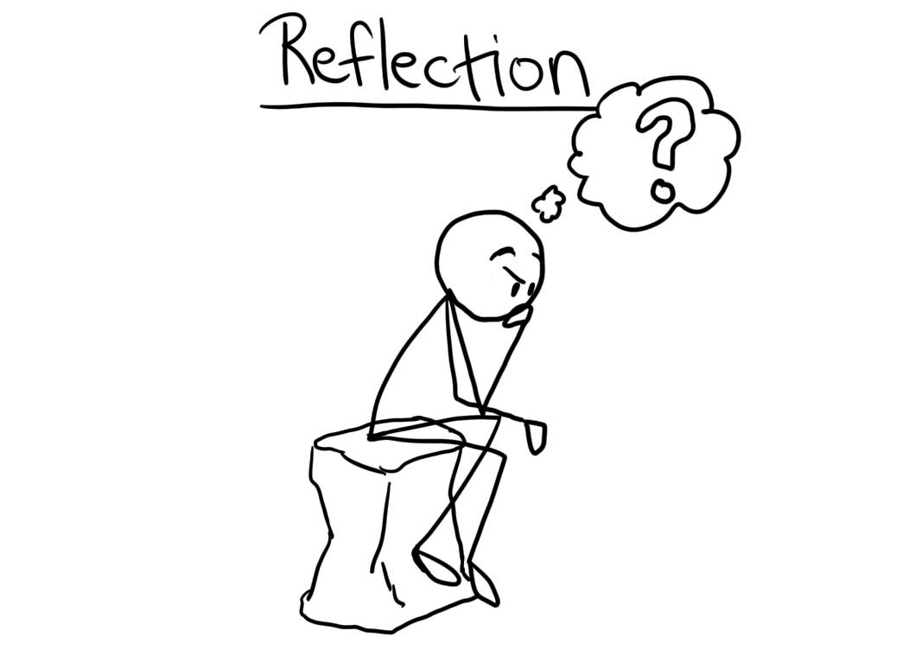
Section 3: Reflection
This section of the internal assessment task requires students to reflect on what undertaking their investigation highlighted to them about the methods used by, and the challenges facing, the historian.

Slide 23
Examples of discussion questions that may help to encourage reflection include the following.
What methods used by historians did you use in your investigation?
What did your investigation highlight to you about the limitations of those methods?
What are the challenges facing the historian? How do they differ from the challenges facing a scientist or a mathematician?
What challenges in particular does archive-based history present?
How can the reliability of sources be evaluated?

Slide 24
Examples cont….
What is the difference between bias and selection?
What constitutes a historical event?
Who decides which events are historically significant?
Is it possible to describe historical events in an unbiased way?
What is the role of the historian?
Should terms such as “atrocity” be used when writing about history, or should value judgments be avoided?
If it is difficult to establish proof in history, does that mean that all versions are equally acceptable?

Slide 26
Bibliography and clear referencing of all sources must be included with every investigation, but these are not included in the overall word count
Total marks: 25 marks
Word Limit is 2, 200 words.
Suggested word allocations:
Section 1: 500 words
Section 2: 1,300 words
Section 3: 400 words
Bibliography: Not applicable
Notes:
Further guidance can be found in history teacher support material

Slide 27
Example 1: To what extent did Hitler create a totalitarian system of government?
Moderator comments
Criterion A: 4 marks
The question for investigation has been clearly stated and it is appropriate. Two sources are identified. (The sources consist only of extracts which themselves appear to have been taken from Hite and Hinton, Weimar Germany and Hitler, which is a shame.) One source is primary. The value relates to its origin but not to its purpose or content and the explanation is not developed. There is repetition of “confusion” without identifying what is meant or how this is relevant to the research question. Limitations are more developed. It has been chosen as an example of the Structuralist viewpoint. Second source is secondary. The origin is not clearly addressed, for example there is no information about the author. The limitations are not fully explained and are little more than generalisations. It is chosen an example of the Intentionalist viewpoint.
Criterion B: 12 marks
This starts with an error, in that Hitler used the Enabling Act to merge the offices of Chancellor and President in 1934 and he became recognized leader of the Nazi party as early as 1921. There is no definition of “Totalitarian System of Government”. There is an attempt to describe the two viewpoints of Hitler’s rule, namely Structuralist and Intentionalist, then critical analysis of the two supported by examples, coming to the conclusion that Hitler’s rule should be seen as a mixture of the two as according to Ian Kershaw. The investigation is focused on the research question and clearly shows different perspectives with a reasoned conclusion. Some examples are given to support both viewpoints but more could have been given and at times the investigation is not developed.
Criterion C: 4 marks
The reflection is clearly focused on what the investigation highlighted to the student about the methods used by historians and challenges facing historians but not the limitations of methods. It is clearly focused on the rest of the investigation.
Total: 20 marks

Slide 28
Example 2: To what extent did World War II lead to women in the United States becoming permanent participants of the labour force?
Moderator comments
Criterion A: 5 marks
The research question is clearly stated and appropriate with a clear explanation. The two sources a clearly identified and also are also appropriate and relevant. Source One is a secondary source. The value is related to the origin as well as the content, although the value in relation to its purpose is not entirely well explained. The limitations are related to the content and in a rather weak way to its origin. Source Two is a primary source. The value and imitations are linked to the content and origin. There is a clear explanation of the relevance of the sources to the investigation and an analysis and evaluation.
Criterion B: 13 marks
The investigation addresses two different viewpoints with a good use of statistics to show women’s incorporation into the workforce during the war. It would have been interesting to have more information on the women’s ages, marital status and sector of the economy. There is also a good use of statistics to show the number of women who left the workforce after the end of the war and the number of women workers in the period 1947-50s, showing long term trends. Reference is made to government plans to encourage women workers but this is not developed. The investigation comes to a reasoned conclusion consistent with the evidence and arguments.
Criterion C: 4 marks
This is very much a personal reflection but it does highlight the methods of historians and the challenges and limitations which they face. It is clearly and explicitly linked to the investigation.
Total: 22 marks

Slide 29
Example 3: How successful was Mao’s attempt to reassert his authority over the party through the Great Proletariat Cultural Revolution? (1959–1968)
Moderator comments
Criterion A: 3 marks
An appropriate research question has been stated. There is an attempt at “scope” which was part of the previous syllabus’ requirements but not necessary here. There is also an attempt to show the relevance of the sources chosen. Source One is a primary source and the limitations and value are explained with reference to the origin, purpose and content but this is not developed and there is also some description of the source. The result of this speech is implicit. Source Two is a secondary source and the value of the book is seen because of the importance of the author. However, there is some contradiction here as the value is seen because the author can “draw on evidence from Chinese and Western sources” but then it is stated there is “limited access to Chinese archives”. This should have been made clearer. Therefore there is some analysis and evaluation of the two sources but reference to the value and limitations is limited.
Criterion B: 11 marks
The investigation is generally clear and well organised and shows the main ways Mao regained power, through control of the PLA, overturning the Beijing power base, developing a cult of personality and control of public communications. The response moves beyond description to include some critical analysis but this is not sustained. There is limited attempt to integrate the sources from criterion A with the analysis. However, evidence from a wide range of sources is used. There is no awareness of different perspectives. The investigation contains critical analysis in that it shows how each factor contributed to Mao’s reassertion of his power. There is a reasoned conclusion.
Criterion C: 2 marks
Here the connection between the reflection and the rest of the investigation is more or less implied. Except for the fact that the author had gathered information from many sources, studied many interpretations and formulated their own conclusion there are only general comments about bias which are not related to the investigation. This is a pity as, for example, one of the sources used is Halliday and Chang’s book, Mao, the Untold Story which is a good example of bias.
Total: 16 marks

Slide 30
Example 4: Why did part of the extra-parliamentary movement see the need to form the Greens in 1980 in West Germany?
Moderator comments
Criterion A: 5 marks
This section starts with a justification for the choice of the research question which is not actually necessary. The research question itself is clearly stated and is appropriate, although the actual wording could have been clearer, eg why did local opposition to the policies of the mainstream political parties lead to the formation of the Greens as a political party within parliament? Two sources are identified and there is clear reference to their relevance to the research question. Source one is a website. The value and limitations are linked to the origin, purpose and content but this could have been more developed. Source Two, a book, is a more developed explanation of the value of this source with regards to its origin and content and there is a clear and detailed evaluation of the limitations of this source.
Criterion B: 13 marks
There is an awareness of different reasons for the formation of the Green Party. These are explained but not fully developed and there is no further reference. The growth of the citizen’s movement is clearly and carefully explained and analysed, together with the growth in importance of environmental issues which was not reflected in the policies of the existing political parties. Detailed explanation of the growth of environmental parties in state elections and finally in the Federal elections is shown with careful reference to a wide variety of sources, including the two which were identified in Section A. The investigation is clear, coherent and effectively organised but there needs to be more evaluation of different perspectives. The conclusion is consistent with the argument and evidence provided and is carefully reasoned.
Criterion C: 4 marks
This was clearly focused on the challenges and limitations facing a historian researching the origins of the Green Party in West Germany. The connection between the reflection and the research question is clear and explicit. The comments on researching in a democracy rather than an authoritarian state were interesting but perhaps not related to research in West Germany, rather than East Germany.
Total: 22 marks

Slide 31
Example 5: To what extent was Pieter Willem Botha an influence to the peaceful end of Apartheid?
Moderator comments
Criterion A: 4 marks
The research question is clearly stated. In the discussion of source one the discussion of origin is connected to value and limitations, although the response is unclear and difficult to follow in places. The connections between limitations and origin are weak, and although there is some discussion of value and limitations related to purpose and content these points are not developed.
Criterion B: 7 marks
This part of this IA moves beyond mere description, but the critical analysis lacks development and clarity. The investigation is under the word limit, and this is reflected in the lack of development of the analysis. There is a limited awareness of different perspectives. As this section progresses it appears to become more of a discussion as to whether Botha or deKlerk was more effective rather than keeping the focus on the question.
Please note: This is an example of an IA where the investigation section is broken down into a series of sub-sections. It is perfectly acceptable for candidates to structure their investigation in this way if they wish to do so. It is not required to provide sub-headings but it can be a useful strategy, particularly for students who might otherwise struggle with how to structure this section of the task. It is also a strategy that some teachers may decide to encourage students to use in the planning stages of their investigation to provide additional support and scaffolding of the task, even if sub-headings are not then used in the final presentation of the investigation.
Criterion C: 2 marks
There is some reflection on the methods used by the historian. The student analyses the problems in assessing bias and value in a variety of sources, albeit simplistically. There is some very basic discussion of the challenges facing historians, although this is very weak and could have been developed far more effectively. The student does make a connection between the reflection and the rest of the investigation in places.
Total: 13 marks

